Slide 1
Design and Development of TourEase: Navigating Bangladesh - Your Ultimate Online Travel Companion.
Project Title
Student Information:
Supervisor’s Information:
Name: Md Abu Bokor
ID :18CSE056
Name: Amit Chandra Barman
ID :18CSE005
Session: 2018-19
Name : Dr. Syful Islam
Assistant Professor,
Department of Computer Science & Engineering,
BSMRSTU,Gopalganj

Slide 2

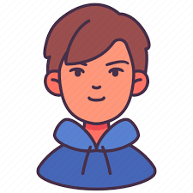
Background
Well. But where we will stay there
and who will guide us?
Do you know any platform
where do we get these?
Let’s go to Coxs Bazar next Friday to
make a great tour.

Slide 3
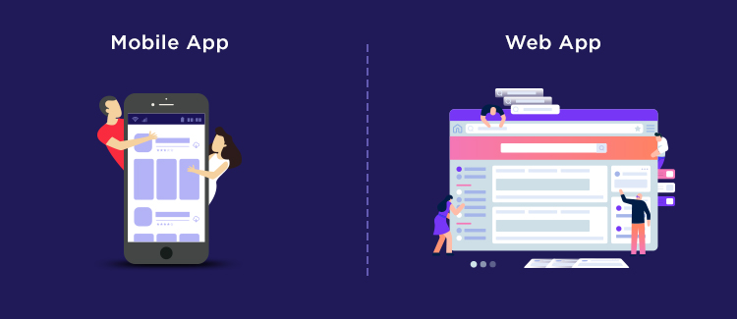
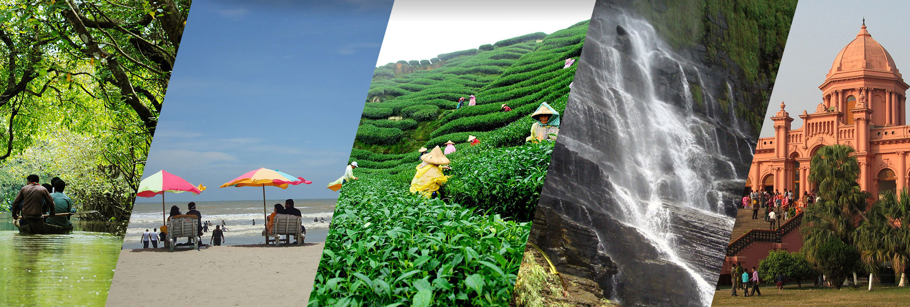
Goal/Statement of Purpose
We're creating a website and mobile application to make traveling in Bangladesh easier and better.
We aim to help tourists, support local businesses, and improve overall travel experiences in Bangladesh.
Image Source :tourtoday.com.bd

Slide 4





Objectives
User-Friendly Web and
Mobile Application
Partnerships with Accommodations and Local Businesses
Easy Booking
User Reviews
Sustainable Tourism
Image Sources: econsultancy.com
,datadesign.me.

Slide 5
Success Criteria
Simplified Travel Experiences
Boosted Local Economies
Increased Transparency through User Reviews
Enhanced Tourism Revenue
Preserving Heritage
Educational Value through Local Guides

Slide 6
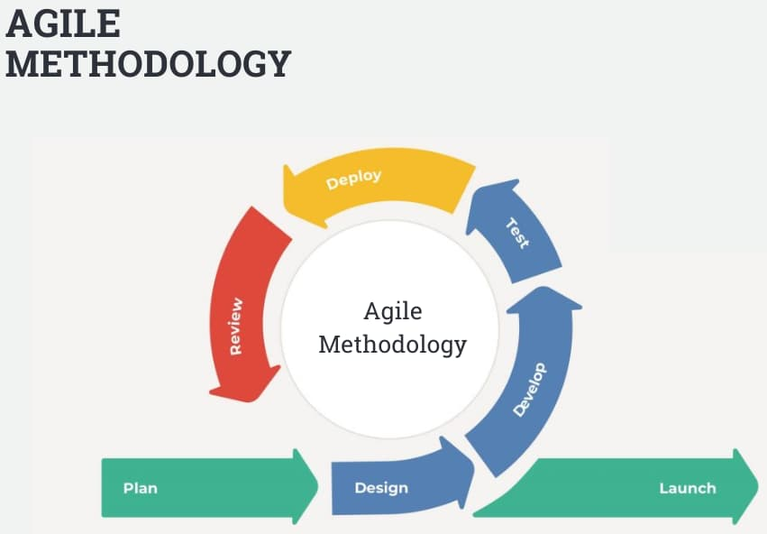
Methods/Approach
We'll follow an Agile method comprising planning, design, development sprints, data integration, user testing and continuous enhancement

Slide 7
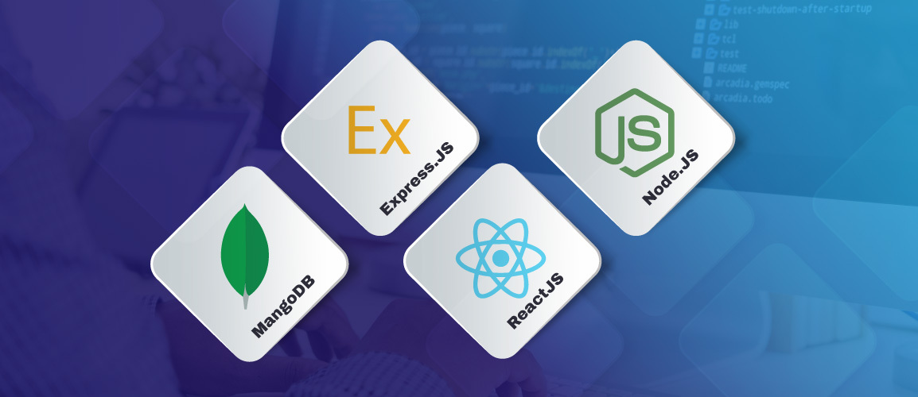
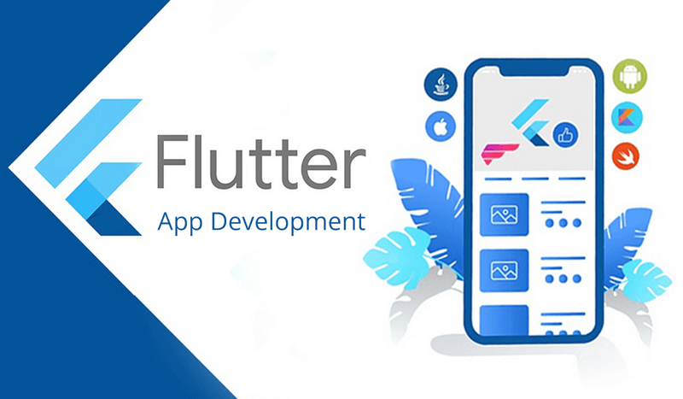
Technology Stack/Resources
For Web: We will use the MERN(MongoDB, Express.js, React, Node.js) stack to make the application.
For Mobile application: We will use Flutter to make a mobile application.
https://www.appify.digital/

Slide 8
Risk/Dependencies
Risks: Challenges in building features, using the MERN stack, and finding accurate data might cause delays. Getting people to use the platform and partnering with hotels could be tough.
Dependencies: We need accurate data from outside sources. Partnerships with hotels and local businesses are important. Feedback from users will guide us.

Slide 9


Expected Time Schedule
Activity Information
Activity-1 Project Initiation and Planning
Activity-2 Design and Prototype
Activity-3 Backend Development
Activity-4 Frontend Development
Activity-5 Continuous Testing and Optimization
Aug | Sep | Oct | Nov | Dec | Jan | Feb | Mar

Slide 10
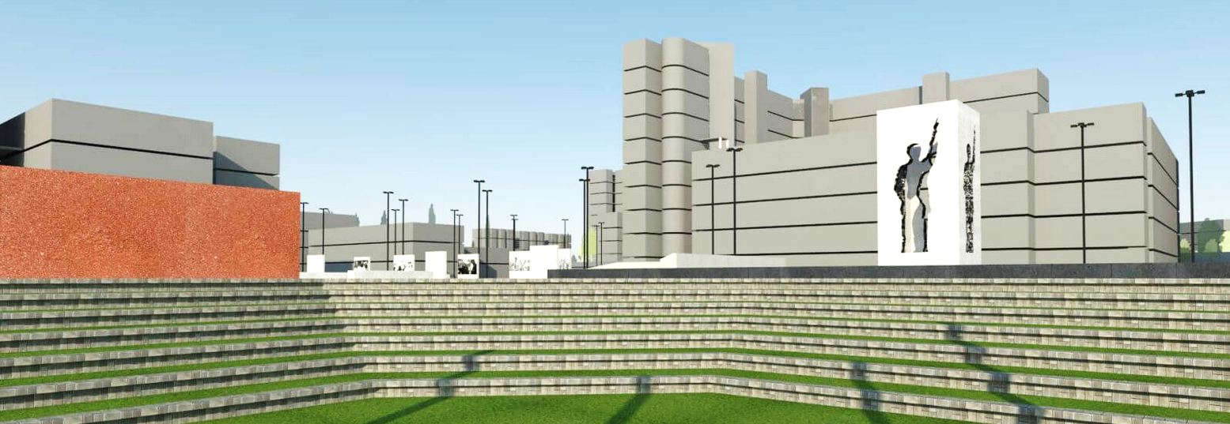
Thank You All
Do you have any Question?

